Slide 1
ULAŞIMDA YAPAY ZEKA
14-06-2023
By
Muhammed MUBAKEROĞLU
Müeyyed ĞARZUDDİN
BİTİRME PROJESİ
BİLGİSAYAR MÜHENDİSLİK

Slide 2
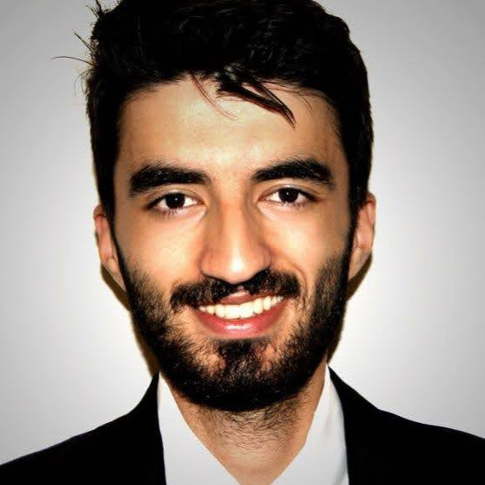

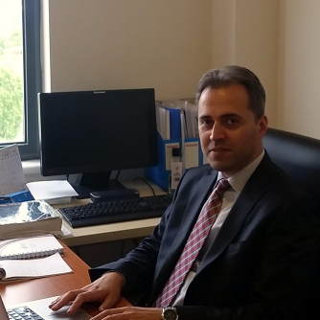
Jüri Üyeleri
Jüri 1 (Danışman)
Jüri 2
Jüri 3
Dr. Ögr. Üyesi MUHAMMED ERDEM İSENKUL
Doç. Dr. PELİN GÖRGEL
Dr. Ögr. Üyesi FATİH KELEŞ

Slide 3
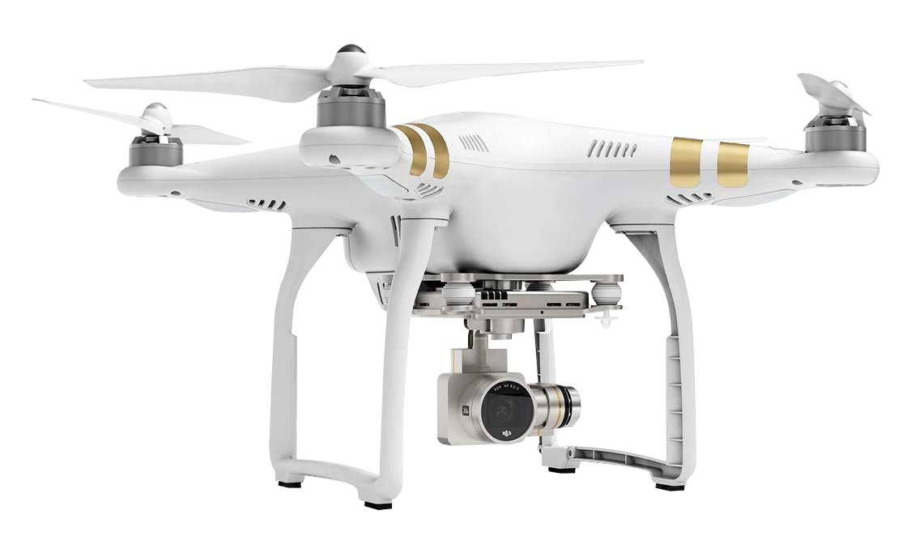
Problem Overview
Nowadays, Artificial intelligence technologies becoming more common and with the spread of embedded systems' devices in all sectors of life, the use of the flying car has become an urgent need in many aspects of life, especially the possibility of achieving the required tasks in a high speed, a good example of use is the field of ambulance.
Within this scope, there is a need to detect objects using a sub-vision camera installed on the flying car to prevent accidents that may be encountered by flying cars. It must be checked that there are no people, vehicles or any foreign objects in these areas.
In addition, flying cars need a visual landing assistant as they land and take off from areas in the city. This assistant needs to identify the Uçan Araba Park (UAP) and Uçan Ambulans İniş (UAİ) areas. It should also be taken into account that flying cars operate in severe weather conditions (rain and snow).

Slide 4
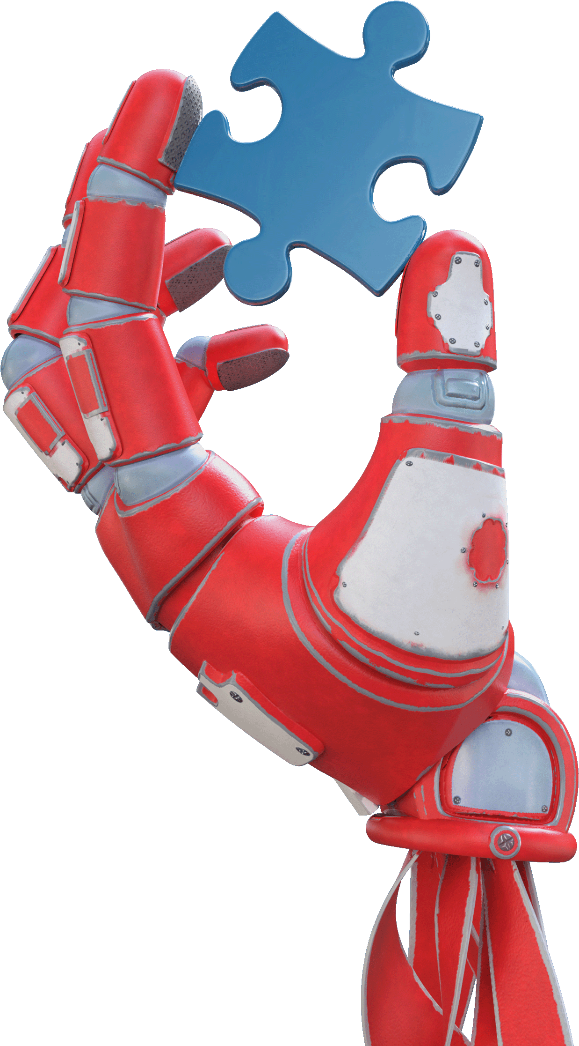
Contribution & Significance
Since artificial intelligence depends on the accumulation of experience to achieve better results, this project is a puzzle piece that contributes to the formation of an integrated panel.
This project directly addresses the need for improved safety in transportation by providing real-time object detection and capability to make instant decisions.
In this project, a neural network model has been created using deep learning techniques. This NN is able to take the captured video as inputs and process them instantly to come up with the desired results.
Notes:
--This project aims to improve transportation safety by providing real-time object detection and decision-making capabilities.
--using a computer vision model yolov8 which benefiting from deep learning techniques.
---help to process captured video to produce the desired results instantly.

Slide 5
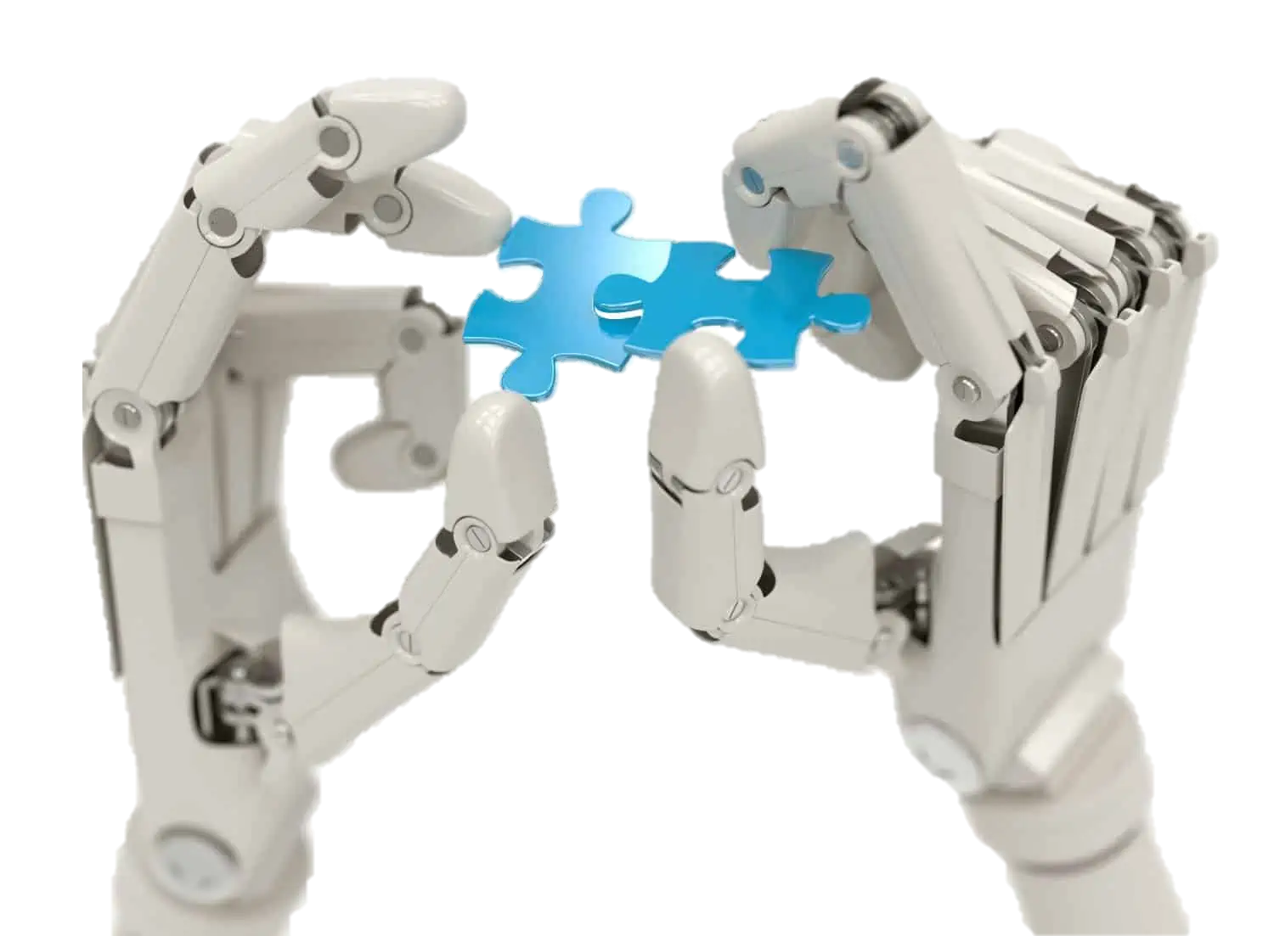
Project Phases
01
02
Collecting Dataset
Labelling Dataset
03
04
Training Dataset
Validation Dataset

Slide 6
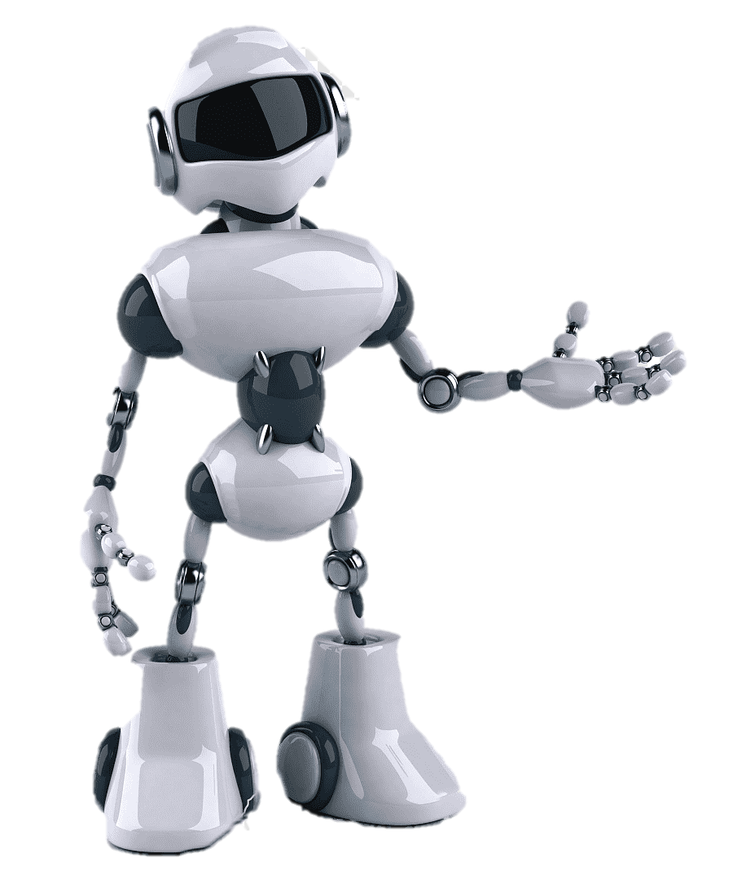
Collecting Dataset
Dataset collection is considered one of the most time-consuming operations in AI projects.
The process of selecting the type of data set containing (UAP, UAI, Vehicle, and Human) images suitable for the project idea has been started. After collecting data from different sources, we added it to our account on the RoboFlow platform to use in the next phase.

Slide 7
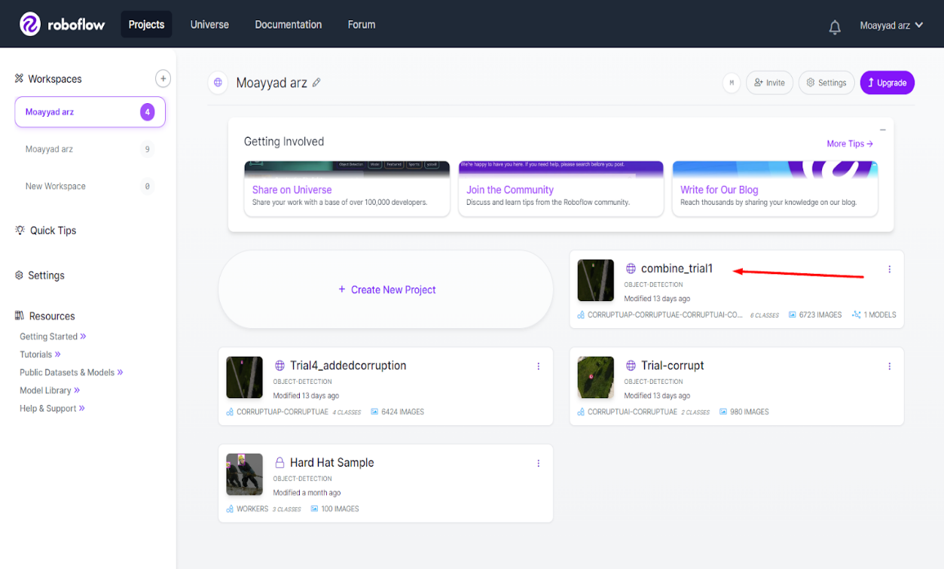
Collecting Dataset

Slide 8
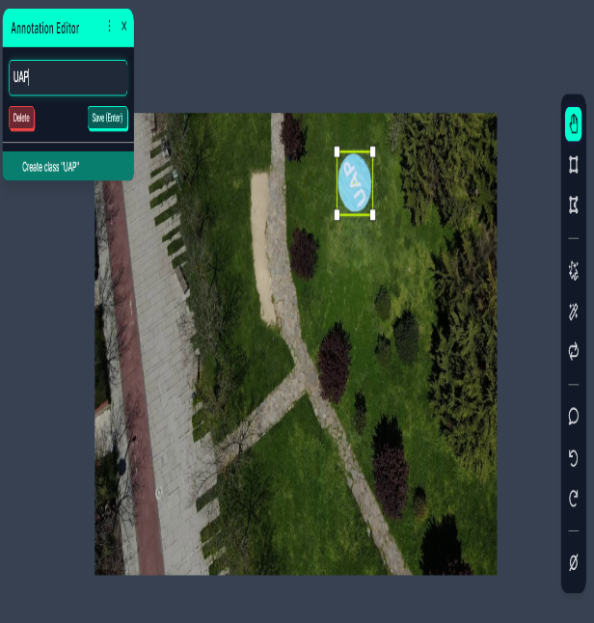
Labelling Dataset
As seen in the images, the labelling process is taken place using the required tools offered by Roboflow platform for finding the objects in the image and boxing them.

Slide 9
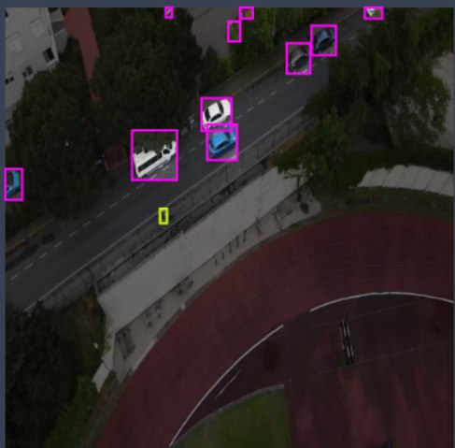
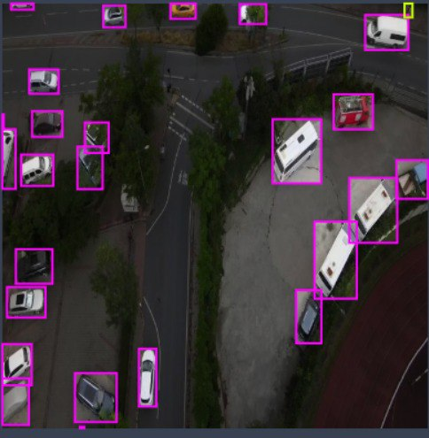
Labelling Dataset

Slide 10
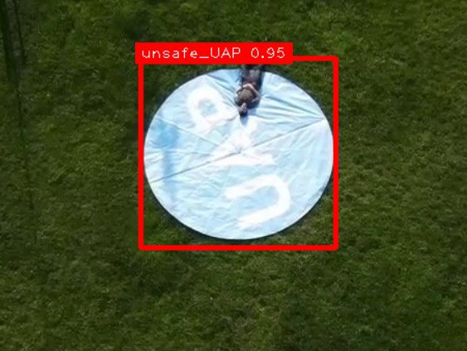
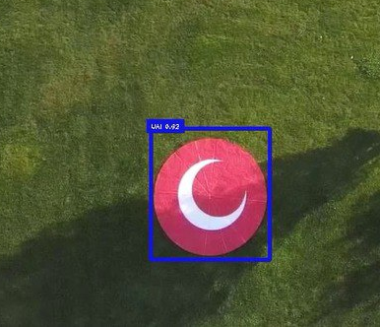
Training Dataset
the structure of yolov8 was chosen to be used in the training process. It has been trained several times using the model's data to achieve the required accuracy in accordance with the project objectives.

Slide 11
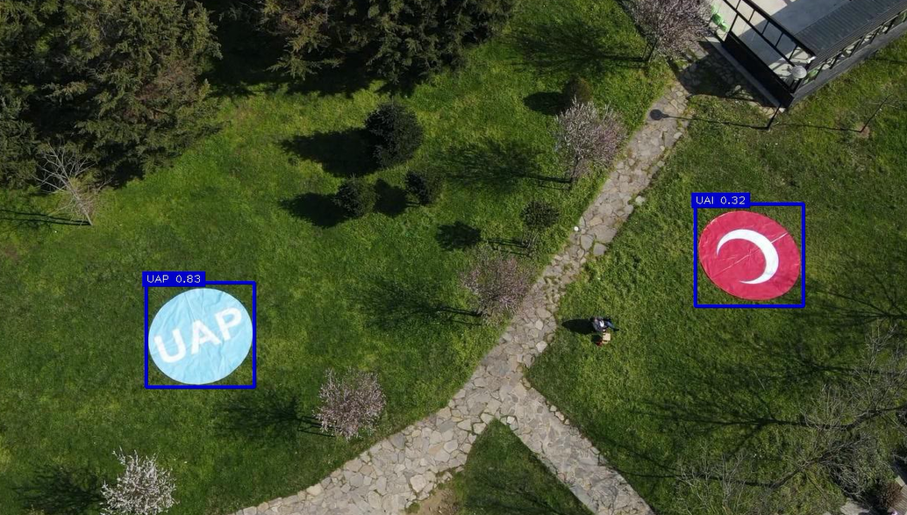
Training Dataset

Slide 12
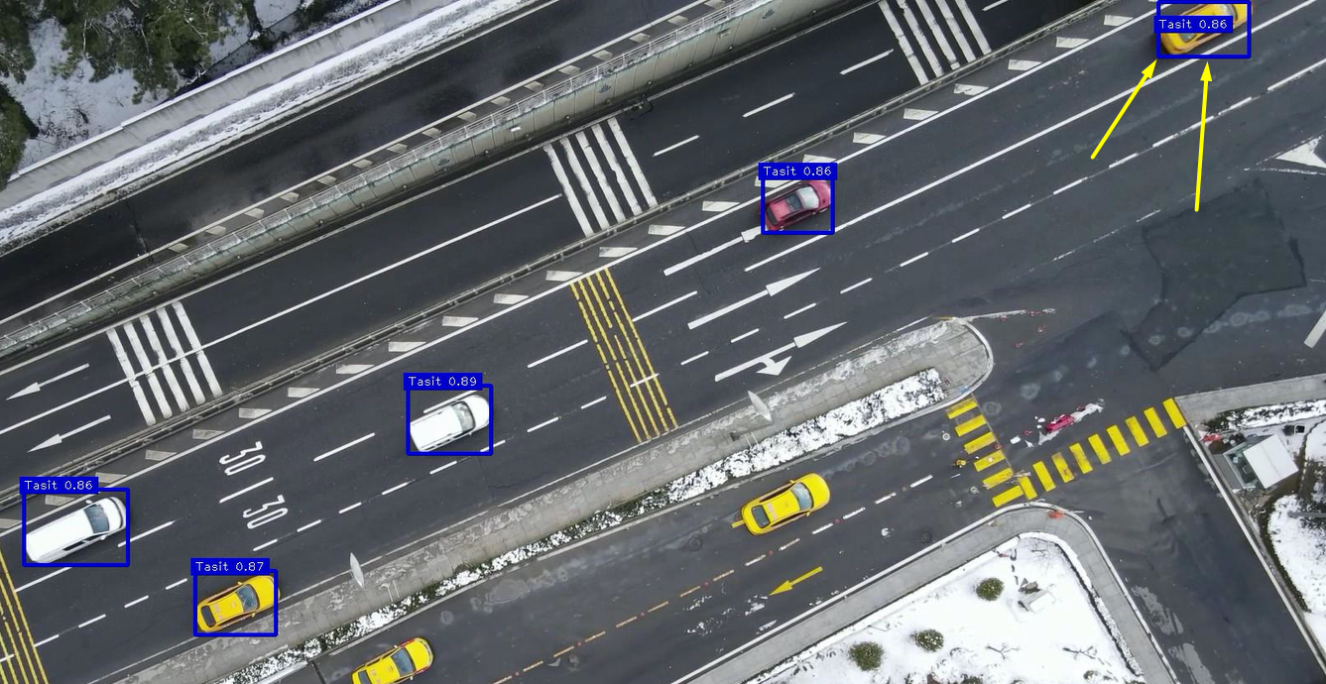
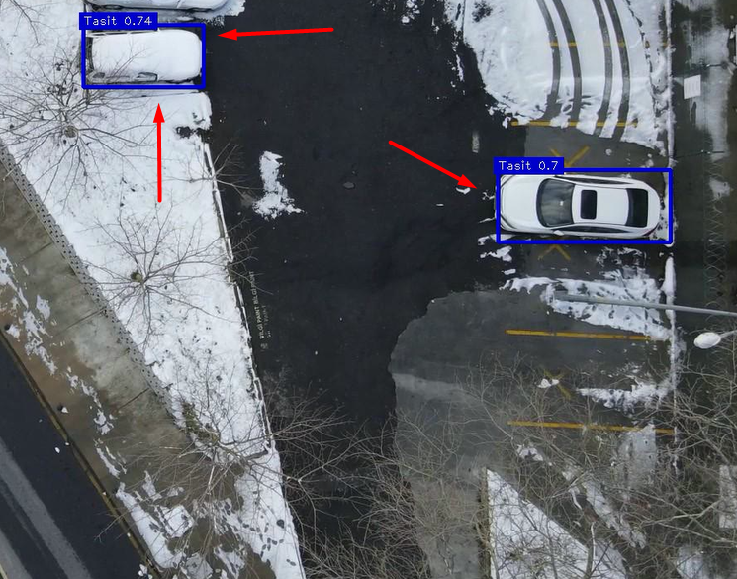
Training Dataset

Slide 13
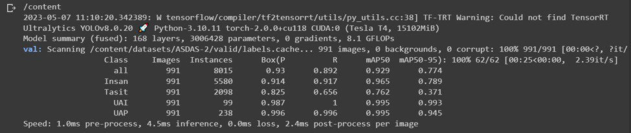
Validation Dataset
The validation set is unused part of the dataset. This part is used to test the dataset.
After finishing the training process several times, the performance of the model was evaluated on the test set to determine how well it generalized to the new data. This step may include calculating various performance metrics such as accuracy, precision, recall, and F1-score.

Slide 14
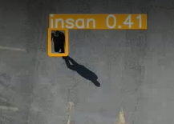
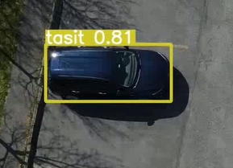
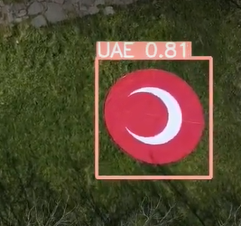
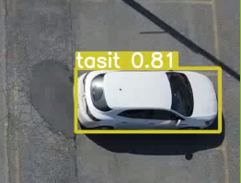
Validation Dataset
Notes:
Here we see pictures that contain objects that have been identified, knowing that this picture was not used in training, and we see excellent results in perception.

Slide 15

Running video

Slide 16
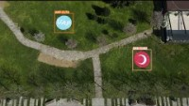
Running Video

Slide 17
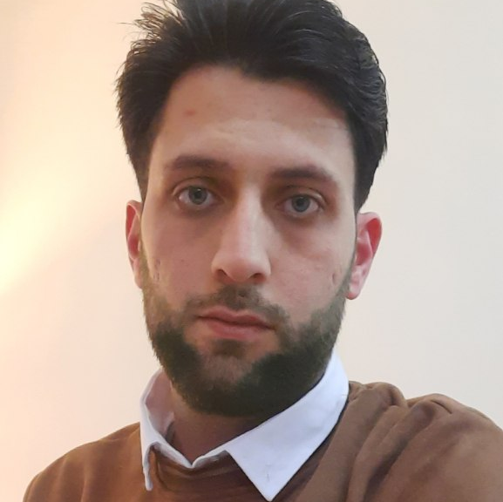

Hazırlayanlar
Muhammed MUBAKEROĞLU
Müeyyed ĞARZUDDİN

Slide 18

Dinlediğiniz için teşekkürler

Slide 19
SORULAR
Sorularınızı cevaplamaya hazırız

